Slide 1
WFIRST Coronagraph SRD Requirements: Threshold and Baseline
CGI Engineering Team
Jan. 13, 2017
Revised 1/18/2017 (BN)

Slide 2
Objective
Go over SRD L2 requirements and provide feedback:
Understood / accepted
Needs clarification
Propose splitting into threshold and baseline
This discussion focused on threshold

Slide 3
Defining Threshold and Baseline
Threshold requirements correspond to minimum science yield necessary for WFIRST CGI mission success (beyond technology demo)
Can defend at the SRR with margin, based on demonstrated CGI performance, existing CGI design and components
Threshold L3 performance currently is:
Static contrast achieved in the lab (with bright pseudo-star)
1.5e-9 / 4.6e-9 for HLC / SPC
10% bandwidth (as tested)
WFIRST pupil
Throughput of the tested design
10x post-processing gain
Requires good LOWFS/C performance and CGI optical stability
EMCCD detector performance at mission end-of-life
Using these parameters in Bijan’s model to evaluate CGI yield vs. SRD requirements
Baseline performance will be better due to mask and algorithm improvements resulting in:
Increased throughput (HLC design with 60% throughput improvement exists)
Improved contrast (new designs and new testbed results, e.g. 18%)
Improved contrast stability (lower drift sensitivity of new designs)
Potentially: existing detector earlier in the mission life

Slide 4
CGI - 2.1; CGI – 2.2
CGI-2.1. WFIRST CGI shall be able to make photometric measurements in the bands defined in the [Filter Table](../Tables/FilterTable.csv) over a spectral range from 442 nm to 980 nm (TBR).
Accept, filters agreed at the last Stanford meeting
subject to later performance/science optimization for the shortest wavelength filter
CGI-2.2. WFIRST CGI shall be able to measure the brightness in the 565 nm filter of a planet at SNR=5 (TBR) within 1 day (TBR) of integration time, assuming a scattered light background equal to the solar zodiacal dust at 1 AU, with system parameters including: a flux ratio of 3e-9 (TBR) at 0.15 arcseconds (TBR) orbiting a V=3 mag star with a stellar radius of 0.5 milliarcseconds (TBR) (e.g. Gamma Ceph A b) and a 2e-9 (TBR) planet at 0.25 arcseconds (TBR), orbiting a V=6 mag star with a stellar radius of 0.4 milliarcseconds (TBR) (e.g. HD 217107c).
HD 217107c cannot be seen under the threshold scenario. Gamma Cephei Ab can be seen, but since it is right at the inner working angle One methodology could be to select planet where there is > 50% time margin at the present time, as defined in the following pages.
Next page(s):
Comparison of various choices of systems as the threshold fiducial system
List of physical observables for the proposed fiducial planet

Slide 5
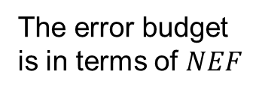
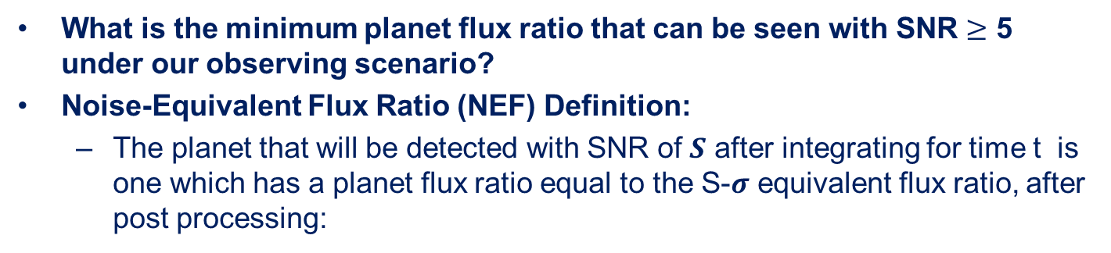

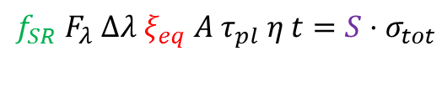


Noise Equivalent Flux Ratio (NEF): $ξ_{eq}$
What is the minimum planet flux ratio that can be seen with SNR $≥$ 5 under our observing scenario?
Noise-Equivalent Flux Ratio (NEF) Definition:
The planet that will be detected with SNR of 𝑺 after integrating for time t is one which has a planet flux ratio equal to the S-𝝈 equivalent flux ratio, after post processing:
R
How dim a planet can be seen with SNR = S ?
SNR: $S=\frac{r_{pl} t}{σ_{tot}}$
T
signal
fraction
Planet signal in the core region after t seconds
area
QE
$$f_{SR} F_{λ} Δλ ξ_{eq}{ A τ}_{pl} η t=S{⋅σ}_{tot}$$
flux
thruput
time
The error budget
is in terms of $NEF$
$$ξ_{eq}=κ{⋅σ}_{tot}$$
$$κ≡\frac{S}{{f_{SR}Φ}_{∗}{A τ}_{pl} η t}$$
This conversion factor is set by the scenario parameters

Slide 6
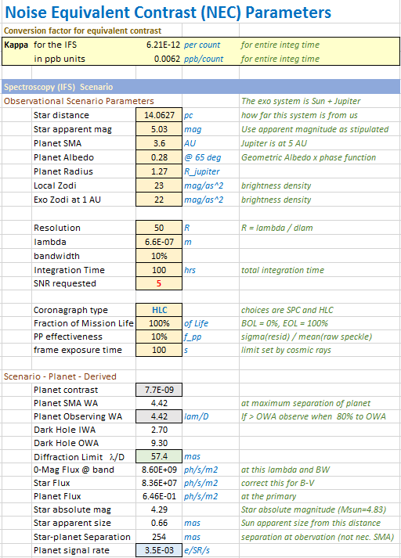
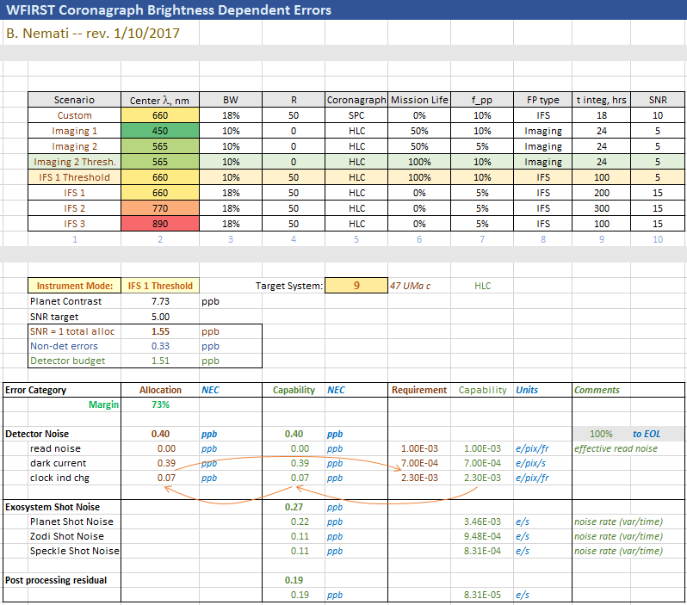
The Brightness Dependent Error and Detector Error Margin
Choose a system: compute the Planet Flux Ratio & NEF multiplier, κ
Compute non-detector errors and subtract to get detector allocation
Compute the margin over capability
A good Threshold is an optimum of acceptable science vs. acceptable risk

Slide 7
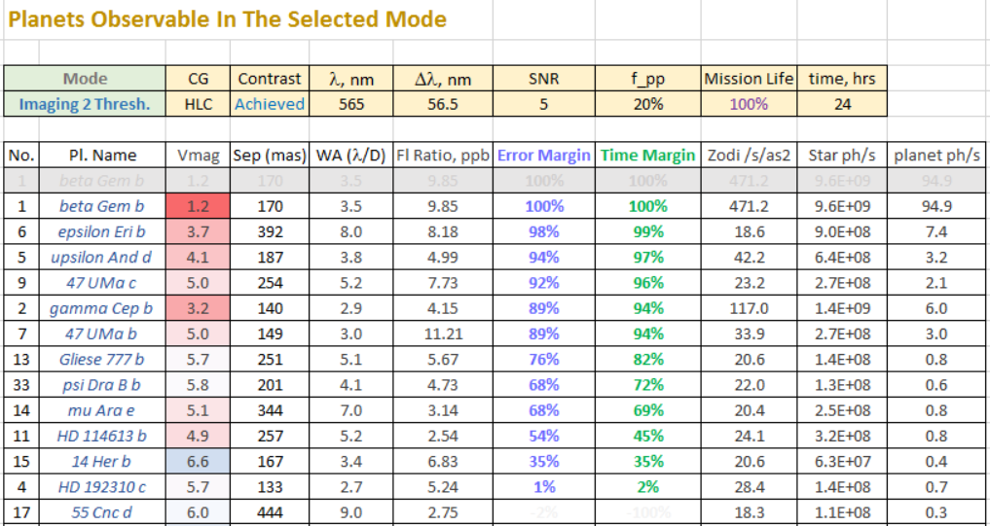
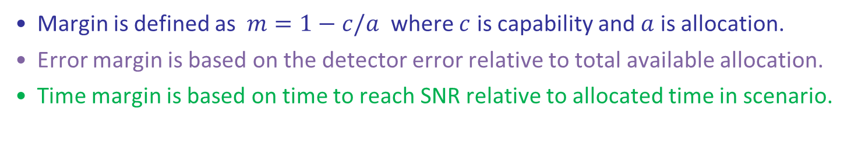
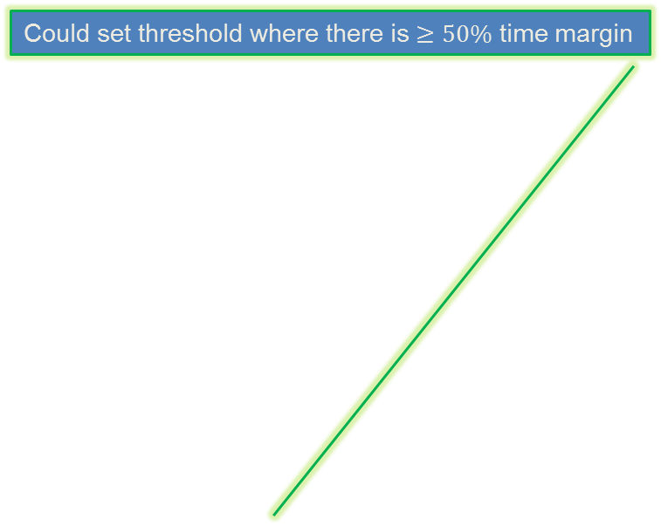
Choosing Threshold Fiducial Case for CGI 2.2
Margin is defined as $m=1−c/a$ where $c$ is capability and $a$ is allocation.
Error margin is based on the detector error relative to total available allocation.
Time margin is based on time to reach SNR relative to allocated time in scenario.
Could set threshold where there is $≥50\%$ time margin

Slide 8
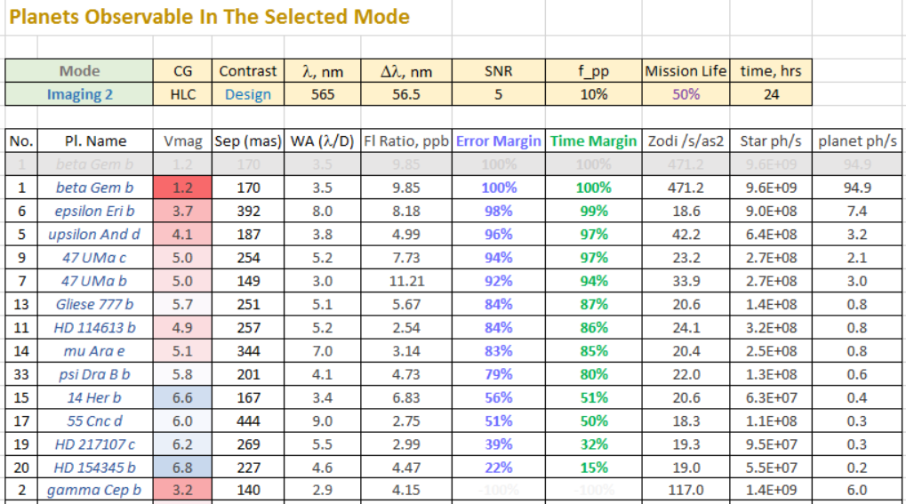
Imaging 2 at mid-mission

Slide 9
CGI – 2.3
CGI-2.3. WFIRST CGI shall be able to detect point sources at a 50% confidence level at a flux ratio of 6e-10 (TBR) and an angular separation of 0.16 arcseconds (TBR) around a star of V=4 or brighter in an exposure time of 48 hours or less (TBR).
This is a baseline only, not threshold requirement
Replace confidence level with false positive probability constraint or replace with SNR=1
Specify the band (565 nm?)

Slide 10
CGI – 2.5
CGI-2.5. WFIRST CGI shall be able to measure exoplanet spectra with R = 50 or greater spectral resolution from 600 nm to 970 nm with bands shown in the Filter Table, with a wavelength accuracy of 5 nm or smaller, and achieve a signal to noise of 10 (TBR) or greater in two bands of 18% (TBR) or greater bandwidth, for a confirmed RV exoplanet (e.g. HD 217107c) at flux ratio of 2e-9 (TBR) orbiting a star of V = 5 mag at separation of 0.25 arcseconds in TBD integration time.
Based on our approach to base threshold requirements on demonstrated results, proposed language modifications:
2.5. WFIRST CGI shall be able to measure exoplanet spectra with R = 50 or greater spectral resolution from 600 nm to 970 nm with bands shown in the Filter Table, with a wavelength accuracy of 5 nm or smaller, and achieve a signal to noise of 5 or greater in one band of 10% or greater bandwidth, for a confirmed RV exoplanet at flux ratio of 5e-9 orbiting a star of V = 5 mag at separation of 0.25 arcseconds in 100 hours integration time. (These parameters represent 47 UMa c)
Baseline performance will be better due to mask and algorithm improvements resulting in:
Increased throughput (HLC design with 60% throughput improvement exists)
Improved contrast (new designs and new testbed results, e.g. 18%)
Improved contrast stability (lower drift sensitivity of new designs)
Prioritize spectroscopy early in mission life to benefit from better detector performance

Slide 11
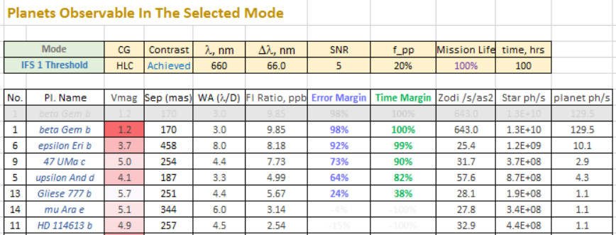
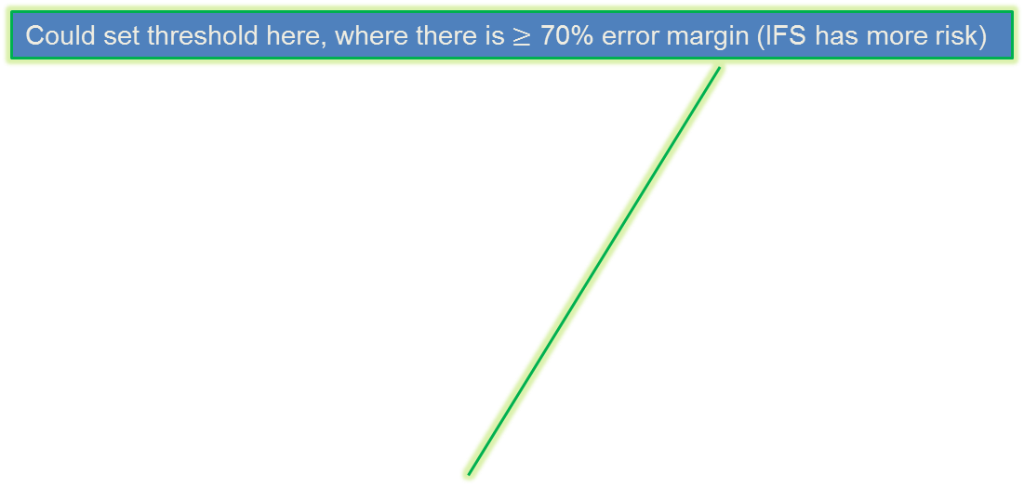
Choosing Threshold Fiducial Case based on CGI 2.5 (IFS 1)
Could set threshold here, where there is $≥$ 70% error margin (IFS has more risk)

Slide 12
CGI – 2.6
CGI-2.6. WFIRST CGI shall be able to measure extended circumstellar emission (e.g. dust) with a a surface brightness relative to the host star of 4e-9 (TBR) per spatial resolution element at SNR = 3 or greater per spatial resolution element from a separation of 0.15 to 0.4 arcseconds in TBD integration time.
Add 565 nm band:
One of the 2 disk bands agreed at the last Stanford meeting
Can’t go longer wavelength given the working angle
Have not had time to explore threshold parameters for inner disks yet, will do for the next meeting

Slide 13
CGI – 2.7
CGI-2.7. WFIRST CGI shall be able to detect circumstellar disks from a separation of 0.9 to 2.0 (TBR) arcseconds at a flux ratio of 1e-7 (TBR) or lower per spatial resolution element.
Our current design does not address this requirement
This requirement covers ~20-40 l/D range, while SPC disk mode covers 6.8-20 l/D range
Without coronagraphic masks, WFIRST psf will not fall off fast enough to meet this requirement without post-processing, even prior to considering relevant spatial frequencies from the optics (can’t add requirements on primary and secondary polishing quality)
Can this science be done with Webb and/or Hubble, or ground based?
Between 2.6 and 2.7 there are no requirements for 10-20 l/D dark hole – should we descope the existing SPC disk mode if there is no scientific motivation for it?

Slide 14
CGI – 2.8, 2.9
CGI-2.8. WFIRST CGI shall be able to distinguish between an exoplanet and an astrophysical background object with 90% confidence (TBR) in three or fewer observations, assuming SNR>6 per measurement, for example, by observation in multiple bands or at multiple points in time.
Are there any CGI engineering L3 requirements originating from CGI-2.8 not already covered in 2.1 and 2.11?
CGI-2.9. WFIRST CGI shall be able map the linear-Stokes polarization of circumstellar disks to an accuracy of 5% assuming a photometric SNR per single resolution element of TBD.
Not a threshold requirement
Do not have a model for assessing this requirement:
Need the associated con ops from SIT’s for this observation
What CGI engineering requirements does this drive?
Roll angle is limited by mission constraints

Slide 15
CGI – 2.10. 2.11
CGI-2.10. WFIRST CGI shall be able measure astrometric parameters including: the orbital semi-major axis to within 20% and eccentricity to within 0.3, for all imaged planets without previous orbital constraints; and the inclination (for a typical RV exoplanet with 52 degree inclination) to within 17 degrees (TBR).
Need the associated con-ops from SIT’s to assess this requirement
Are there any CGI engineering L3 requirements originating from CGI-2.10 not already covered by 2.11?
Aside from having a “reasonable” engineering overhead for each observation to enable revisits
CGI-2.11. WFIRST shall be able to measure the spatial separation of an exoplanet from its parent star to an accuracy of 5 milliarcseconds (TBR) assuming SNR=10, including systematic errors.
Lambda/D/10 or 0.2 pixels. Reasonable assuming SNR = 10.
We accept this requirement

Slide 16
CGI – 2.12, 2.13
CGI-2.12. WFIRST CGI shall be able measure the photometric brightness in the 661 nm filter at SNR of 5 or greater for point sources at a flux ratio of 1e-7 (TBR) at 0.3 arcseconds (TBR) separation orbiting R = 14.2 mag, V=15.1, I=13.1 (TBR) stars.
Not a threshold requirement, needs further analysis / refinement before accepting as baseline:
Assuming no LOWFS/C improvement to pointing for such a dim star, 20 mas pointing error. ~1e-6 contrast.
How long would we have to observe for target this dim?
CGI-2.13. WFIRST CGI shall be able to record and transmit wavefront control system telemetry in parallel with science data, including raw wavefront sensor measurements and commanded deformable mirror actuator values.
We accept this requirement

Slide 17
Backup

Slide 18
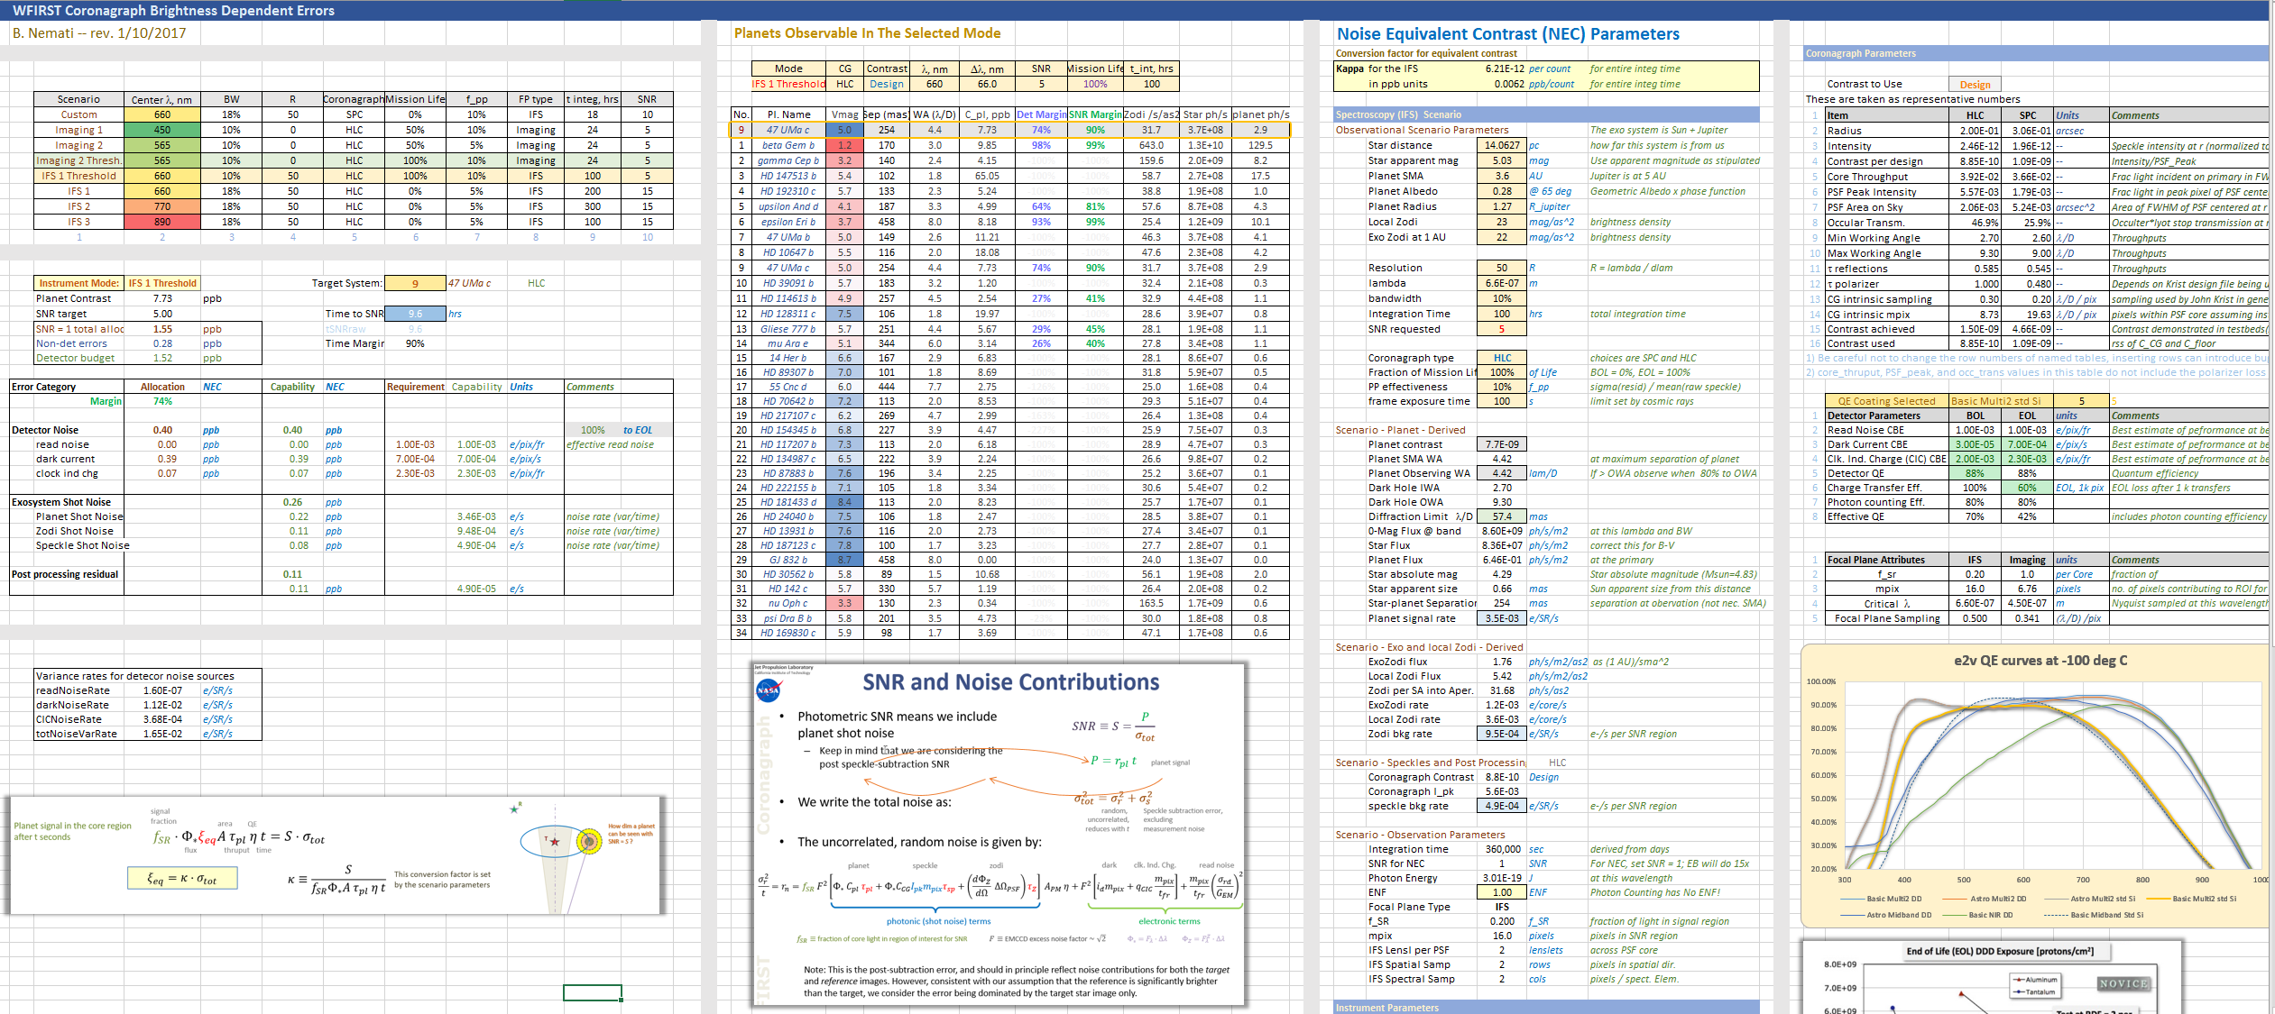
The Brightness Dependent Error Budget

